Slide 1

Worsening Nitrate Pollution in Minnesota’s Drinking Water
Anne Weir Schechinger, Environmental Working Group

Slide 2
Data Evaluated
EWG analyzed MDH finished water nitrate tests for public water systems using ground and surface water.
EWG looked at community water systems (CWS) and non-community water systems, but this report only focuses on the trend in CWS.
In total, 901 active CWS serving almost 4.4 million people tested for nitrate at least once between 1995 and 2018.
This report focuses on CWS that had elevated nitrate tests- i.e. at least 1 nitrate test >= 3 mg/L between 1995-2018.

Slide 3

Methodology Used to Evaluate Nitrate Trends in MN
Calculated correlation coefficients for each community water system to evaluate if each system’s nitrate tests were correlated with year.
  The correlation coefficient, or ‘r’ value, “calculates the strength of the relationship between the relative movements of two variables.”
If a system’s nitrate tests are positively correlated with year -> nitrate is going up over time.
If a system’s nitrate tests are negatively correlated with year -> nitrate is going down over time.
A few systems also had zero correlation, meaning nitrate stayed the same over time.

Slide 4
Main Findings
Elevated Nitrate: 115 CWS had elevated levels of nitrate between 1995-2018 (at least 1 test >=3 mg/L).
Increasing Nitrate: between 1995-2018, nitrate levels rose in 63% or 72 out of the 115 Minnesota communities with elevated nitrate
  This contamination impacts over 218,000 Minnesotans.
Disproportionate Impact: EWG also found rising nitrate contamination among 67% of the 24 communities that are already facing the worst nitrate drinking water contamination (systems that had at least 1 test >=10 mg/L)
  This contamination impacts 48,500 Minnesotans.

Slide 5
Community Water System Impacts
 | System Count | Systems with worsening N | % with worsening N | Population with worsening N
Community systems >=3 | 115 | 72 | 63% | 218,000
Community systems >=10 | 24 | 16 | 67% | 48,500

Slide 6
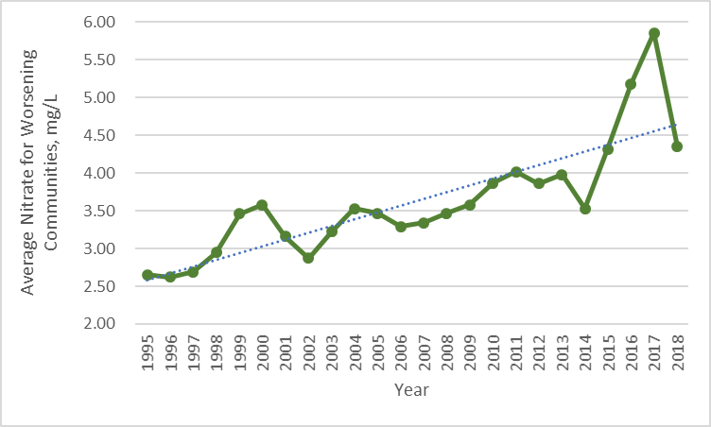
Climbing Contamination
In the 72 communities with worsening contamination, average nitrate levels increased 61% from 1995-2018.
In 1995, average contamination was 2.7 mg/L. By 2009, average contamination had increased to 3.6 mg/L and continued climbing to 4.4 mg/L in 2018.
*Spikes in nitrate contamination in the Rock County Rural Water System and the City of Fairmont drove the sharp increase in average contamination in 2016 and 2017.

Slide 7
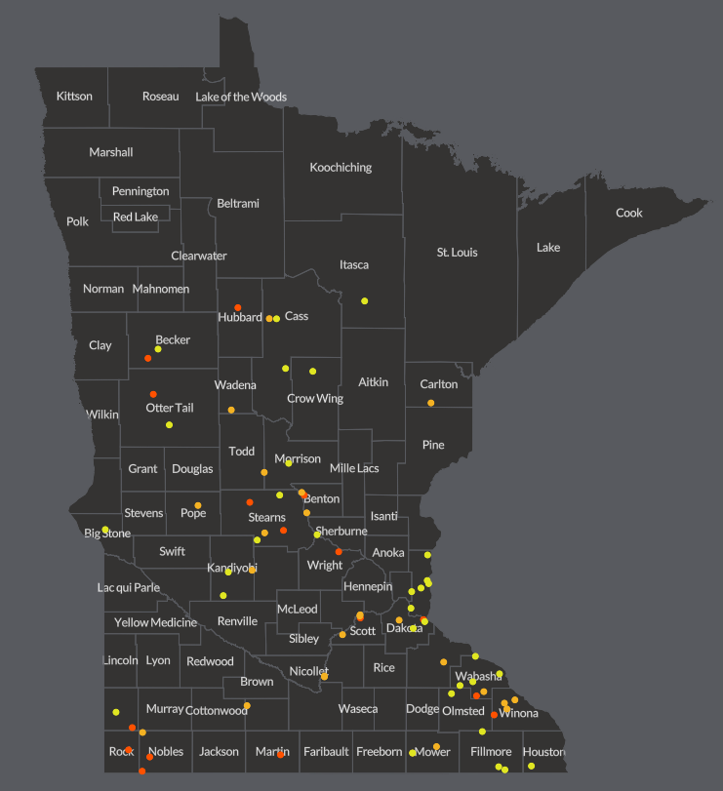
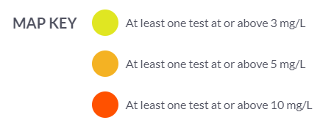
EWG’s Interactive Community Water System Drinking Water Contamination Map

Slide 8
Known Private Well Contamination, but More Data Needed to Evaluate Trends in Private Wells
Minnesota does not collect, or require private well owners to collect, private well data with same frequency as public well data.
The state does not have enough data on private well nitrate contamination for EWG to evaluate trends in private wells.
We do know, based on our previous analysis and reporting, that 3,364 private wells in the state have already tested at or above 10 mg/L between 2009-2018 and are unsafe for human consumption.
Assuming an average of 3 people per household, this most severe private well contamination already impacts 10,092 Minnesotans.
It is likely that nitrate contamination has also increased over time in private wells, since many draw water from the same groundwater sources as community water systems.
More data on private wells should be collected, to fully understand
trends in private wells and to protect public health.

Slide 9
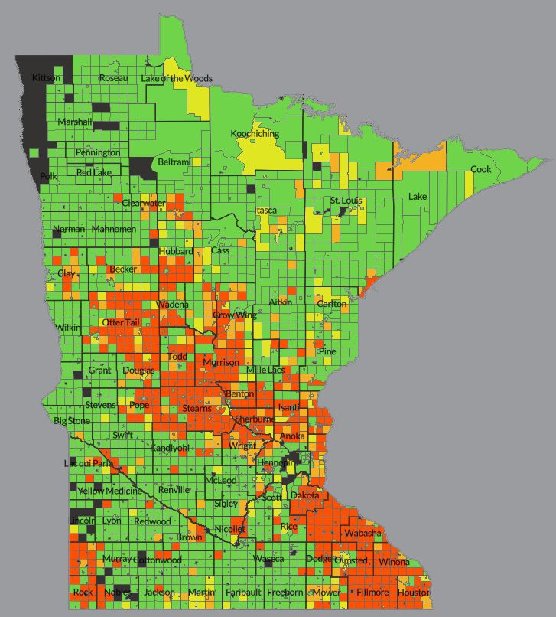
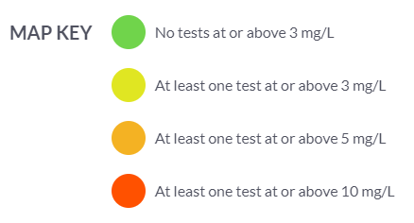
EWG’s Interactive Private Well Drinking Water Contamination Map

Slide 10
Environmental Justice Implications
Of the 72 Minnesota community water systems with worsening contamination, 61% were in a U.S. Census block group with median household income below the state’s average.
51% of all private wells with at least 1 test >=3 mg/L between 2009 and 2018 were in a U.S. Census block group with median household income below the state’s average.
The University of Minnesota Water Resources Center has conducted studies on the high costs of treating nitrate contaminated drinking water, and our analysis shows that these high costs are falling on many of the Minnesotans who can least afford treatment.

Slide 11
Cost of Nitrate Treatment
According to MDH, 8 Minnesota community water systems installed nitrate treatment between 1994 and 2018.
Total capital costs across the 8 systems, not including operating or maintenance costs, were $30.65 million.
System Name | 2018 Population Served | Capital Cost | Capital Cost Per Person
Adrian | 1,211 | $934,286 | $771
Clear Lake | 525 | $696,452 | $1,327
Edgerton | 1,171 | $498,204 | $425
Ellsworth | 462 | $629,693 | $1,363
Hastings | 22,335 | $4,230,578 | $189
Lincoln-Pipestone Rural Water System | 13,644 | $2,593,429 | $190
Saint Peter | 11,784 | $21,044,857 | $1,786
Sundsruds Court | 40 | $18,843 | $471
Total | 51,172 | $30,646,342 | $599

Slide 12
Questions?

Slide 13
More Info About the Study

Slide 14
Statistical Significance
Calculated the t statistic and p value for each system to see if the positive/negative correlations were statistically significant.
  “Statistical significance is the likelihood that a relationship between two or more variables is caused by something other than chance.”
Community systems with worsening nitrate were more likely to be statistically significant than those with nitrate levels that improved.
 | Community system count | % of community systems | Statistically significant count | % of increasing/decreasing that are statistically significant
Community systems >=3 with increasing nitrate | 72 | 63% | 43 | 60%
Community systems >=3 with decreasing nitrate | 40 | 35% | 20 | 50%

